Slide 1
Effectively Diversifying Your Pottery Business Income
Ryan Durbin
@rdceramics

Slide 2
Agenda
About Me
Ways to sell your pottery
Preferred selling avenues
Real numbers from 2020 and 2021
Keeping track of your income streams
Q&A

Slide 3
About Me
Married with 2 cats
Full time job, part time potter
Pottery history
Very analytical/business minded
Host a pottery/small business podcast with Becca: Wheel Talk Podcast
Long term aspirations

Slide 4
Ways to sell your pottery
In-person shows
Online
Consignment
Wholesale
Commission
This doesn’t cover everything!

Slide 5
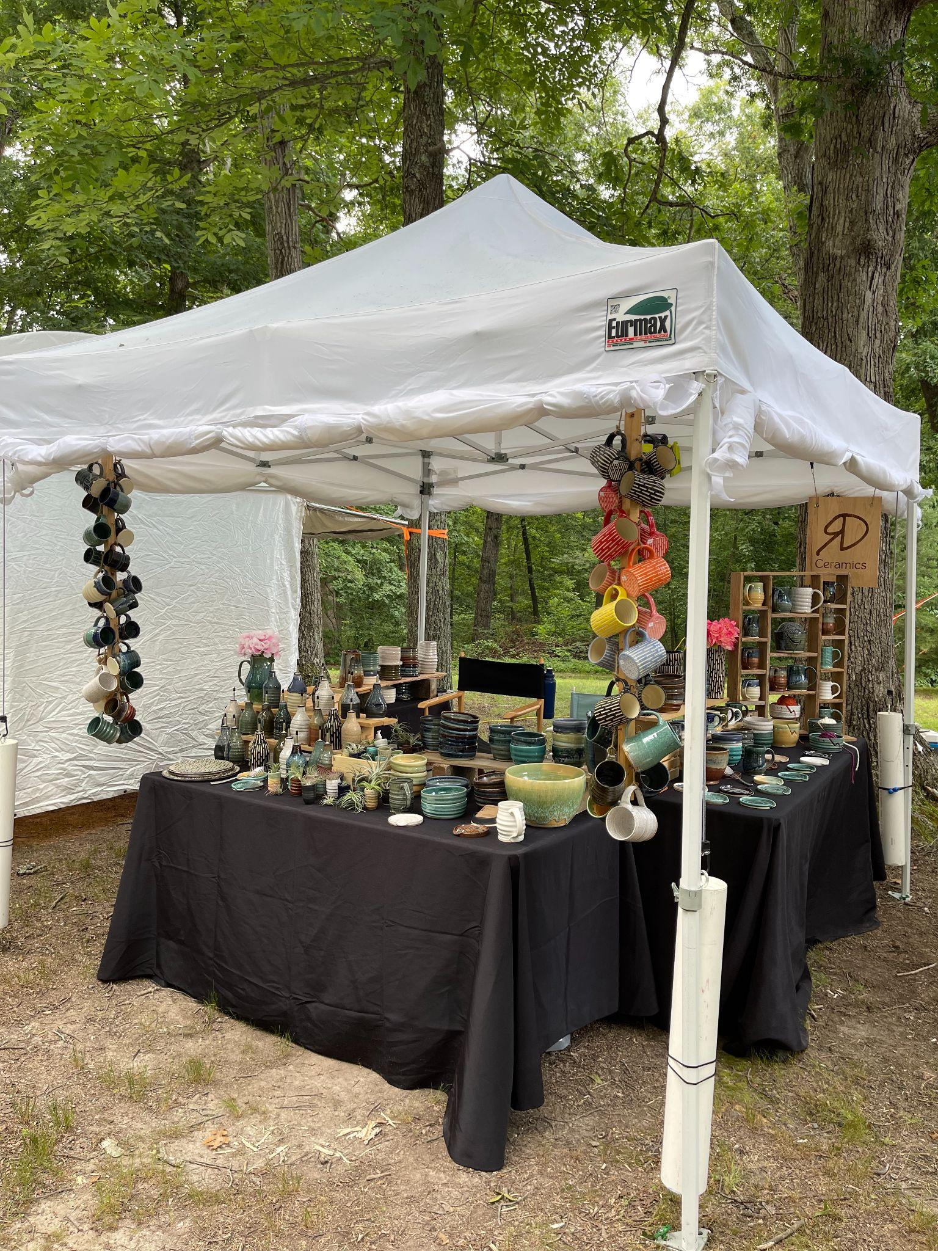
In-person show
Pros/Cons
Great for you if…
Wheel Talk podcast episodes
3, 8, 45, 49, 86, 87, 99, 110
* interview
Notes:
Pros:
Direct access to customers
Immediate feedback about your work
Better connection/building of your local customer base
Setup your booth based on your specifications
Cons:
lots of equipment for outdoor shows $$
Time involved to pack, travel, & sell at show
Long hours over the weekend normally
Weather
Costly booth fees, handle sales taxes
Great for you if:
You like the interaction with people (extrovert or a people person) & like having the same conversations a lot
You live in an area with lots of show options for people to get out
You enjoy the immediate wrap & deliver process
You like making a lot of money all in a day or 2
You have weekends available to sit out at a show all day
You like setting up a shopping experience with customers
You want to grow your local customer-base

Slide 6
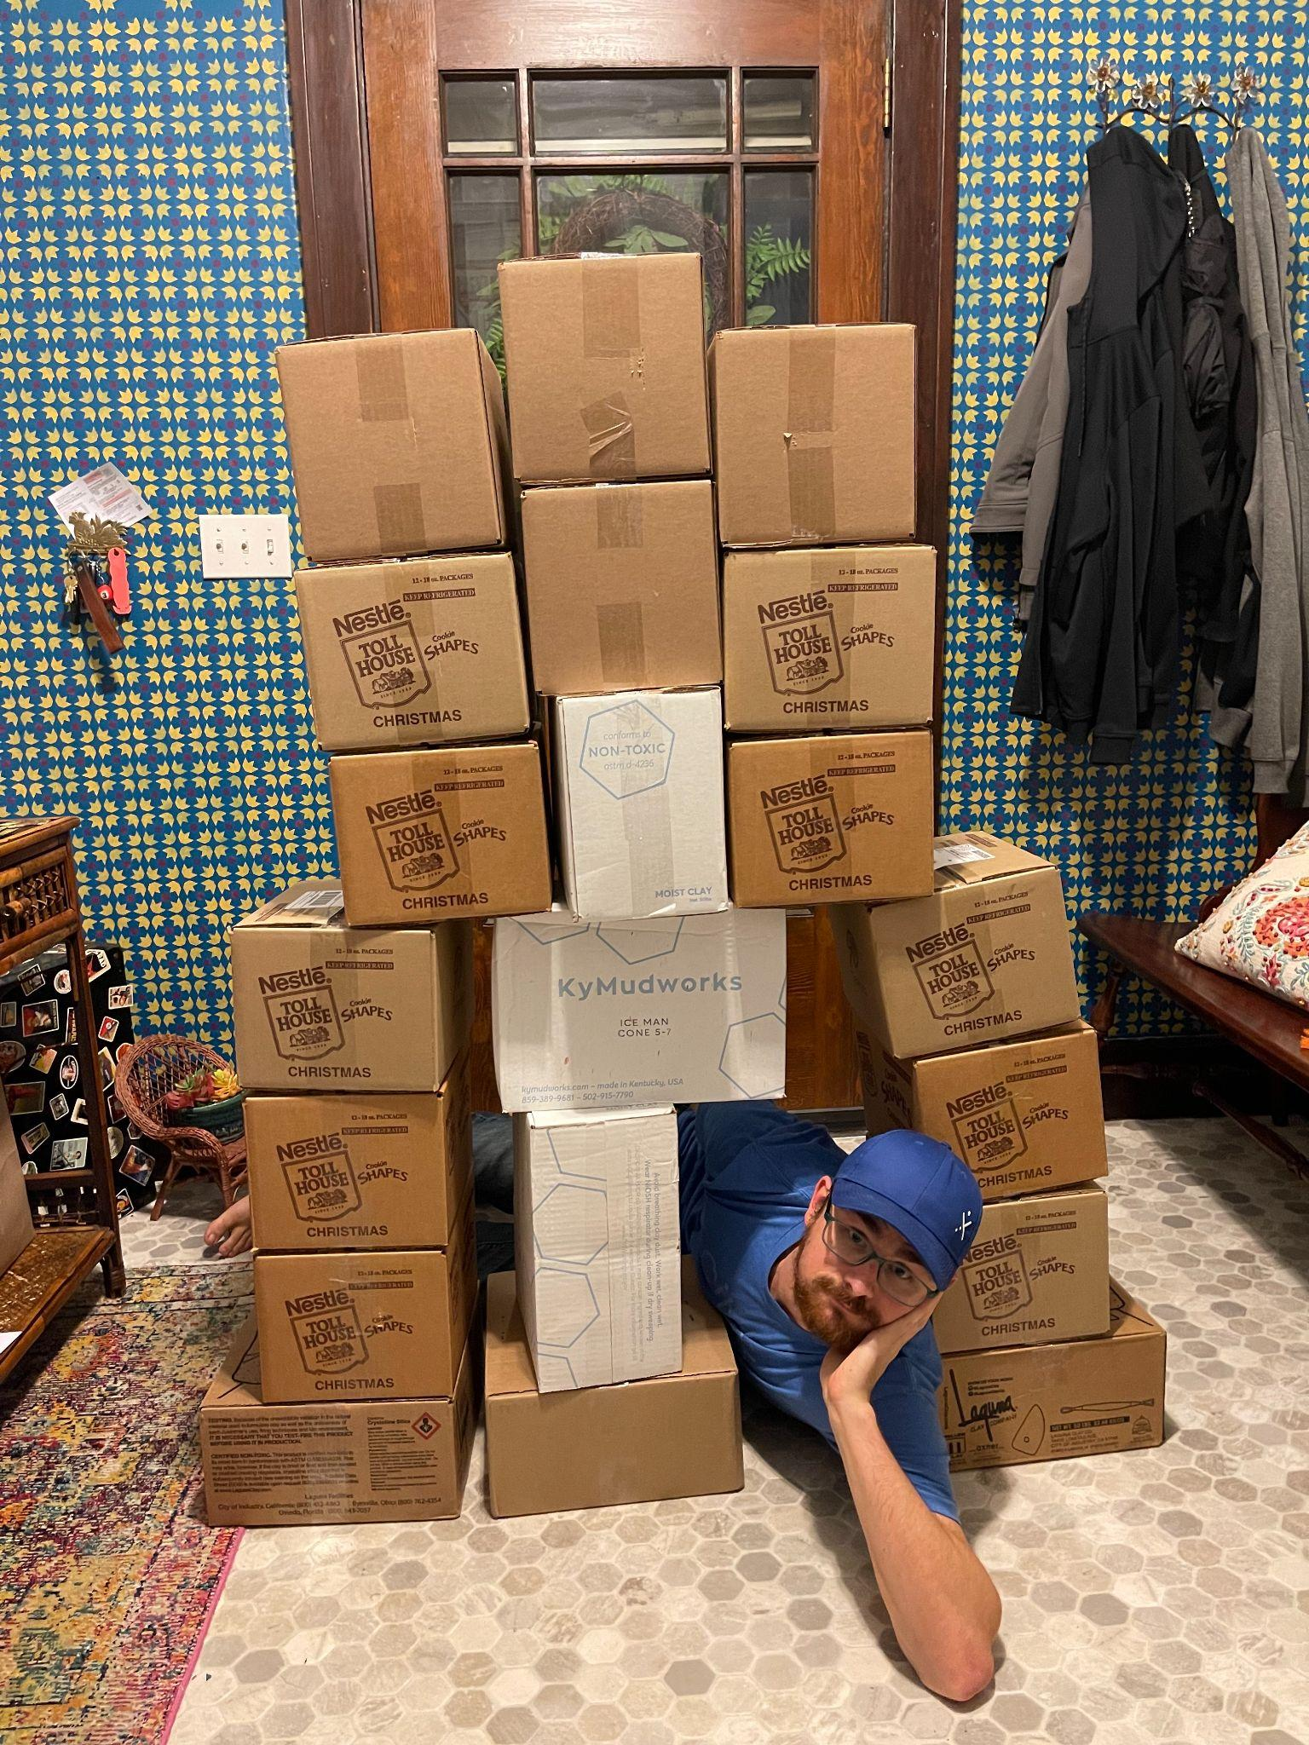
Online
Pros/Cons
Great for you if…
Wheel Talk podcast episodes
49, 50*, 52*, 59*, 83, 88*, 103, 119*
* interview
Notes:
Pros:
sell from your home/studio
You choose how you want everything displayed/portrayed by photos/videos
You choose when/how you want to sell things
Possibility for customer testimonials about your products/service
Efficient process/timeline possible from making to completion to shipping
Cons:
need a strong online customer base that follow your work
Medium effort (time, complexity) upfront to start selling
Need a good plan for packing & shipping process (void fill, boxes, labels, etc)
Need equipment/skills to portray your work best for online consumption
Good camera/phone, lighting, background, “photographer eye”
Risk for breakage, additional cost potential down the road
Handle sales taxes yourself
Online platforms takes a cut (5-15% normally)
Great for you if:
You have an online customer base/mailing list to drive traffic
You have an interest in photography
You don’t like the immediate one-on-one with people, introverted
You enjoy marketing your work to an online customer base through social media
You need scheduling flexibility when selling (scheduled restocks, no need to meet a show deadline)
You enjoy packing and shipping, can send out an order on a whim
You have close access to a post office or otherwise

Slide 7
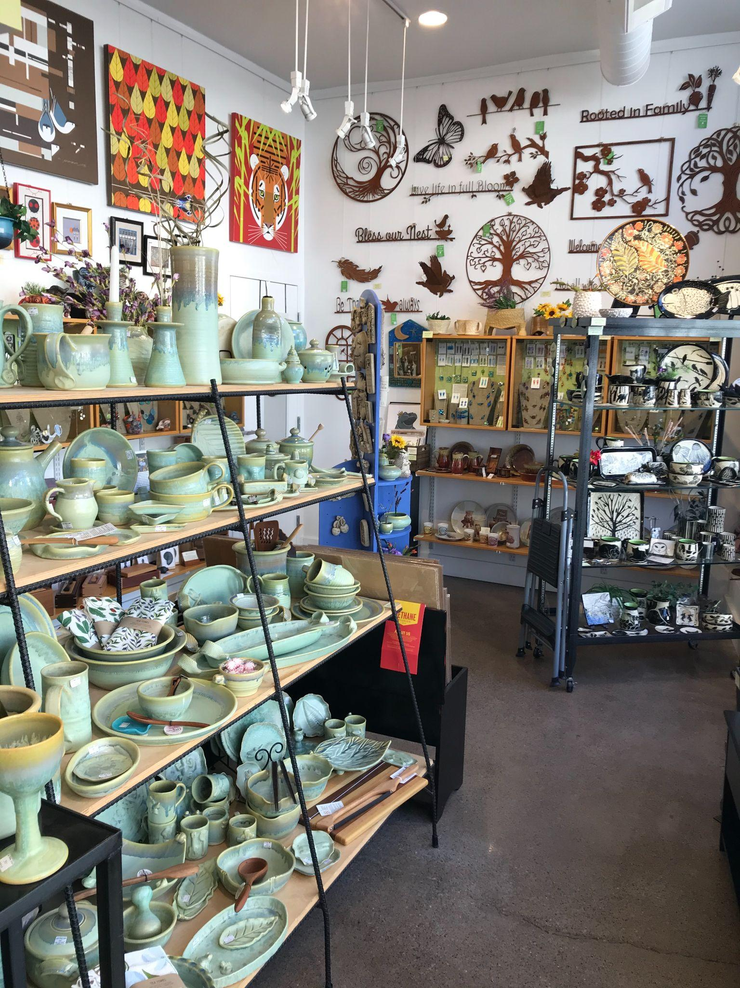
Consignment
Pros/Cons
Great for you if…
Wheel Talk podcast episodes
5, 49
Notes:
Pros:
daily/regular hours for a brick and mortar to sell your work to local customers
They handle collecting & paying sales taxes for you
Regular checks & Inventory sales (hopefully) that can give you good data about what items sell best at that shop
Increased sales during heavy gift giving season (mothers day, Father’s Day, holidays)
Cons:
shop takes big percentage (30-40% normally)
No direct connection with the customers
Sometimes requested to stock very specific pieces for their shop only
Can be a lot of work to prep orders to deliver
regularly need to keep up with shop communication & plan accordingly for restocks
Great for you if:
You enjoy making the same thing over and over
You enjoy working with other businesses vs end users/customers
You can work to seasonal deadlines for delivering products
You can produce items efficiently and can make a profit when selling at 60-70%
You like figuring out what products work with the shop’s customer base
You want to increase your local customer base

Slide 8
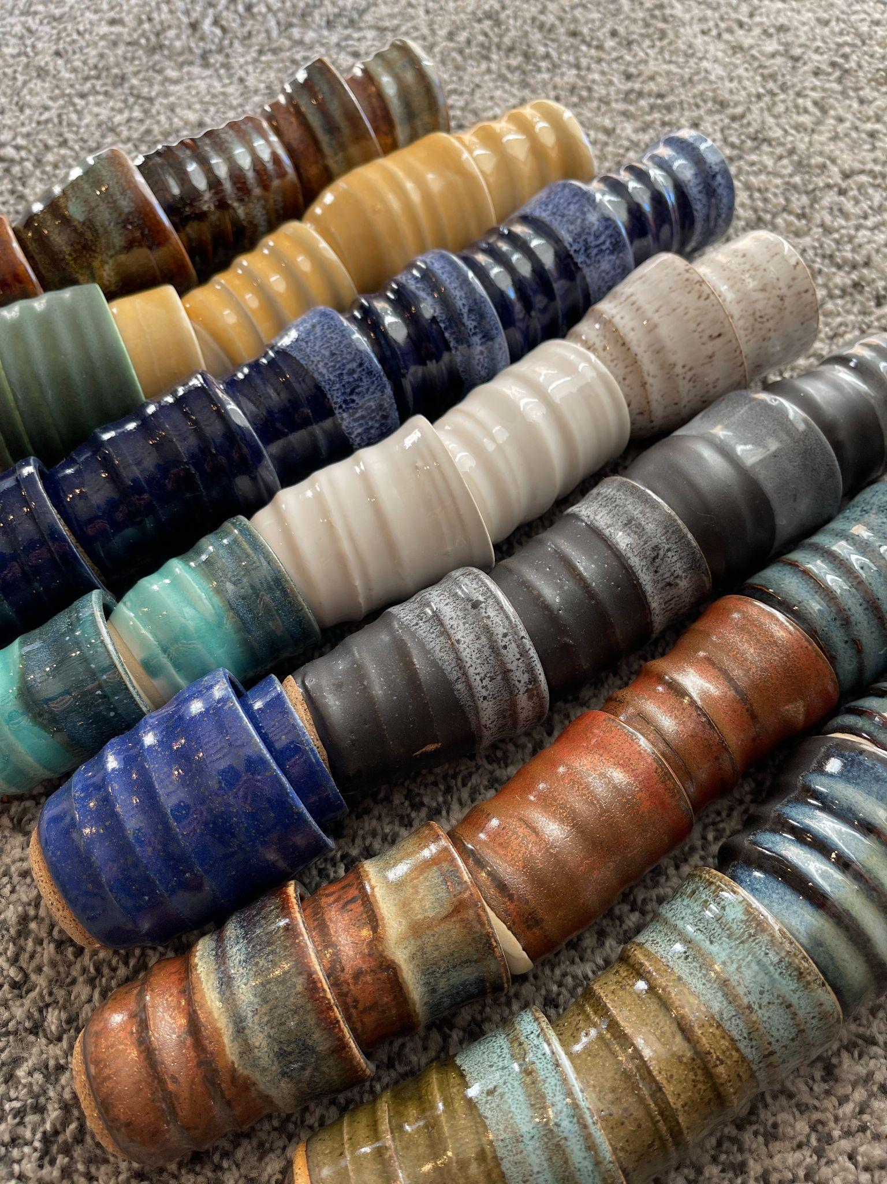
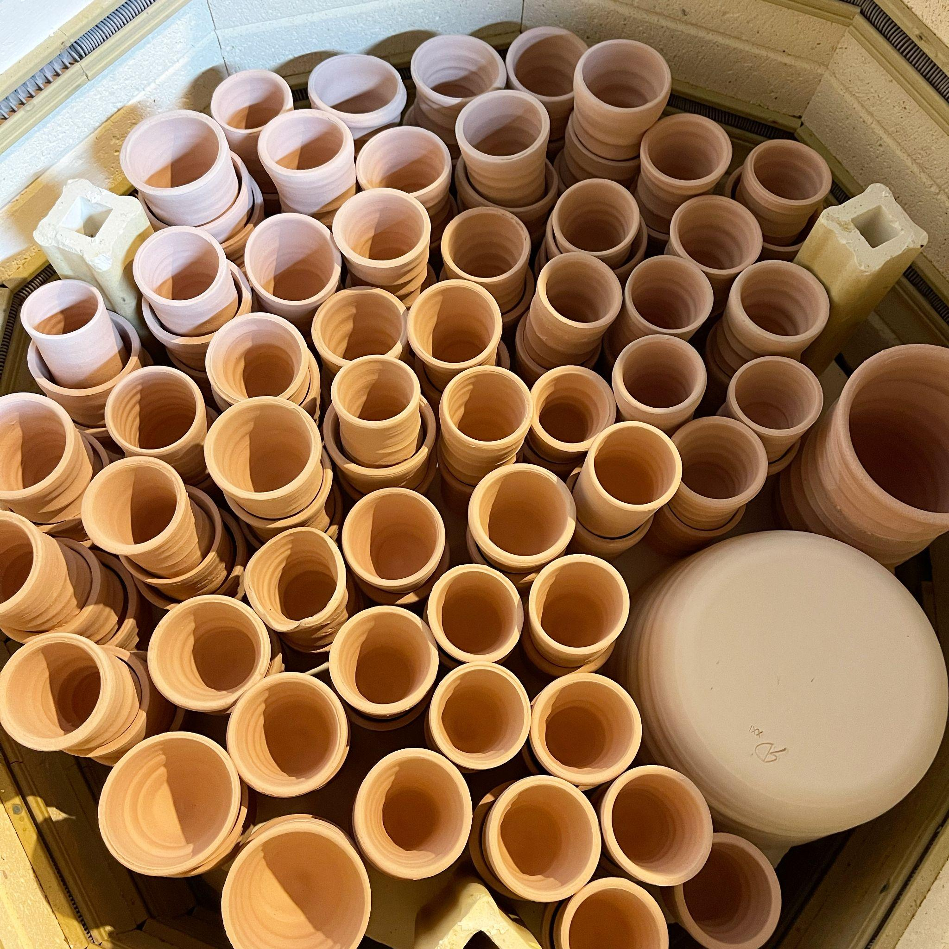
Wholesale
Pros/Cons
Great for you if…
Wheel Talk podcast episodes
35*, 49, 51, 91*, 116*
* interview
Notes:
Pros:
money upfront, net 30
High quantity/consistency forms
Regular orders, room for growth with satisfied customers
No need to sell the work to the end customer
Cons:
need to have ample inventory to fulfill orders and other selling avenues
Price cut at 50% normally
Reordering times can be random
Not sure when stock is running low
Lot of packing for shipping large orders, choose wisely what you want to offer with shipping in mind
Your pieces have to be PERFECT
have to be able to produce consistent pieces one to the next
Can be hard to find wholesale clients, they come to you normally or you have to find shops and inquire about a wholesale relationship
this relationship is more B2B and tests more of your business skills
need to have contracts/policies in place to handle your wholesale client relationship
Minimums, exchanges, shipping & handling
Great for you if:
You enjoy making the same thing over and over
You enjoy working with other businesses vs end users/customers
You can produce items efficiently and can make a profit when discounted 50%

Slide 9
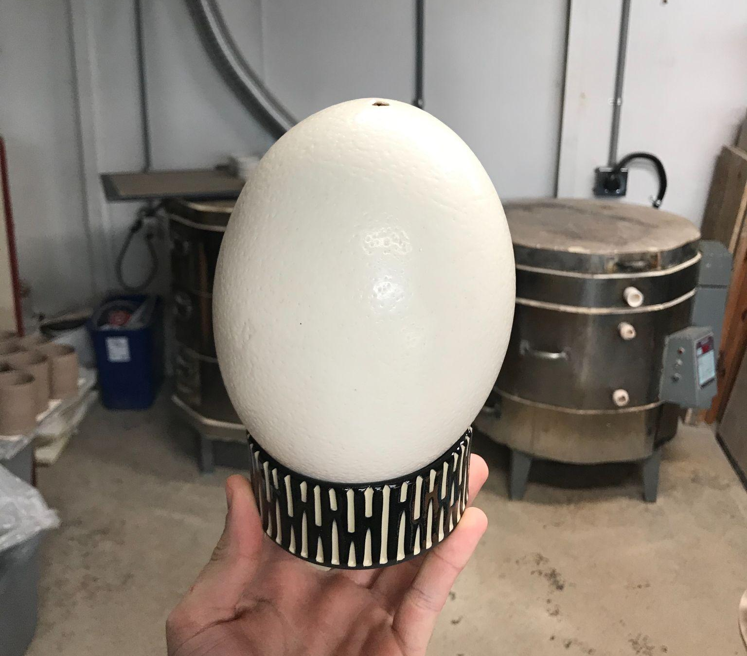
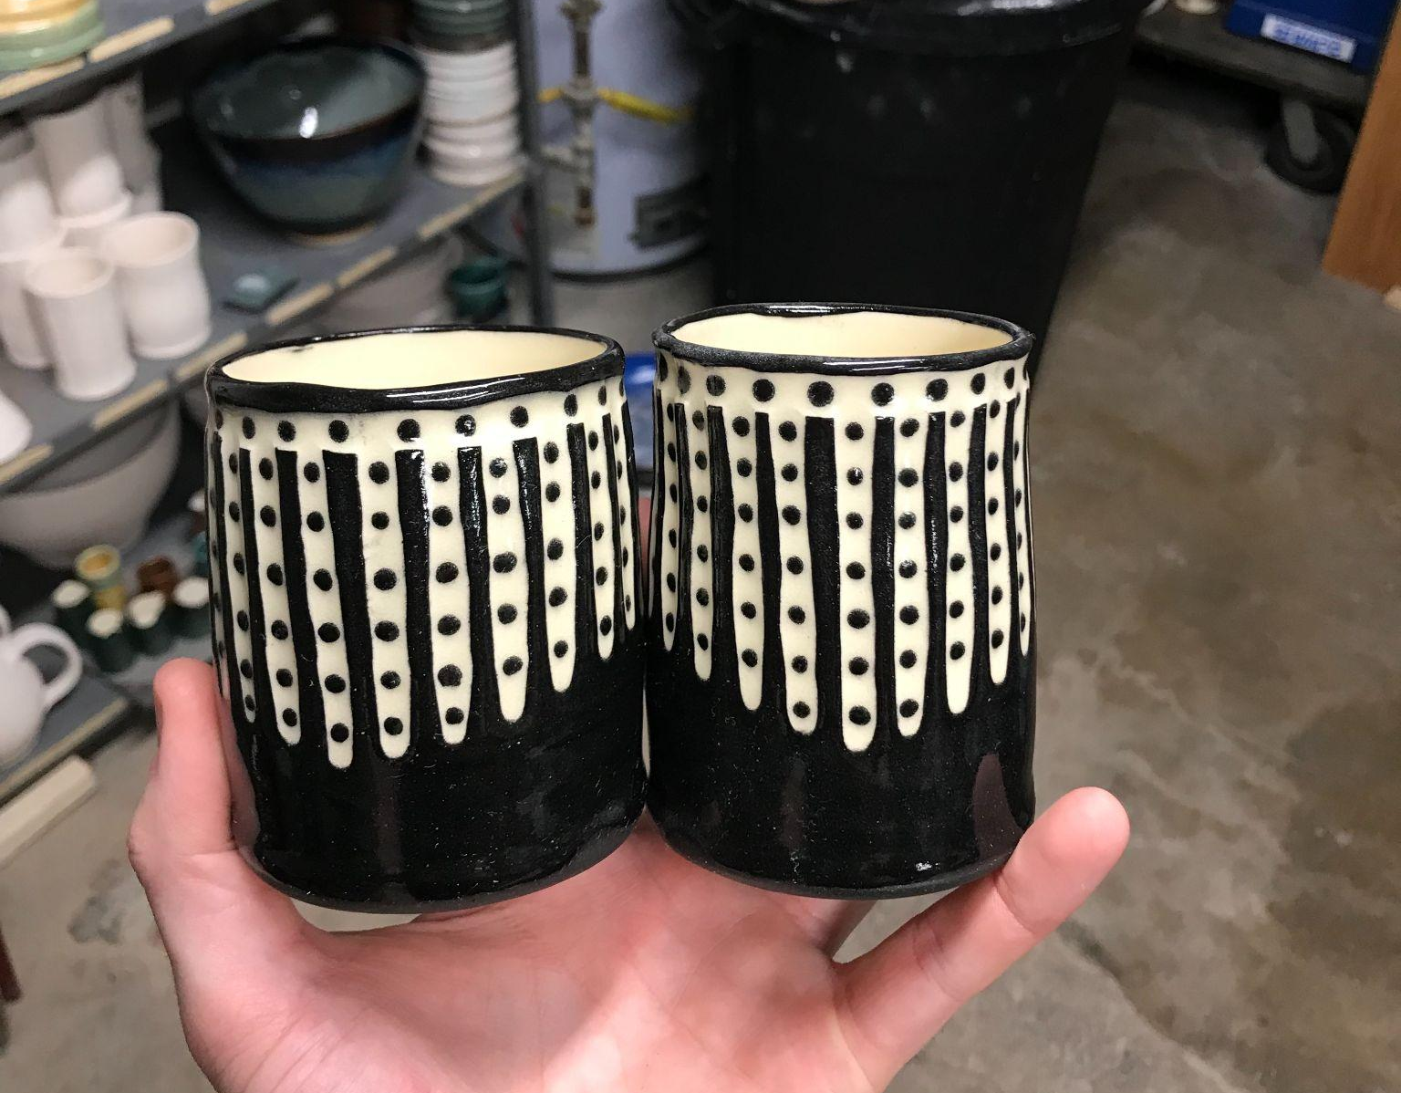
Commissions
Pros/Cons
Great for you if…
Wheel Talk podcast episodes
26, 49?, 60*
* interview
Notes:
Pros:
challenging for your skills & creativity
Guaranteed money
Make something specific to a customer’s needs
You don’t have to think about what to make
Set your own timeline, flexible
Cons:
Requires lots of customer interaction
May need to set expectations about limits of the medium/craft/skillset
Chance of having extras that are not sellable
Can be less profitable if you don’t get paid appropriately
Can be more unknowns in the process (something breaks, glaze mishaps, etc)
Great for you if:
You like making a customer’s vision a reality
You like making things for a specific use/purpose
You know how to effectively estimate your time and costs for a project
You can communicate well with non-technical customers who may not know about your process

Slide 10
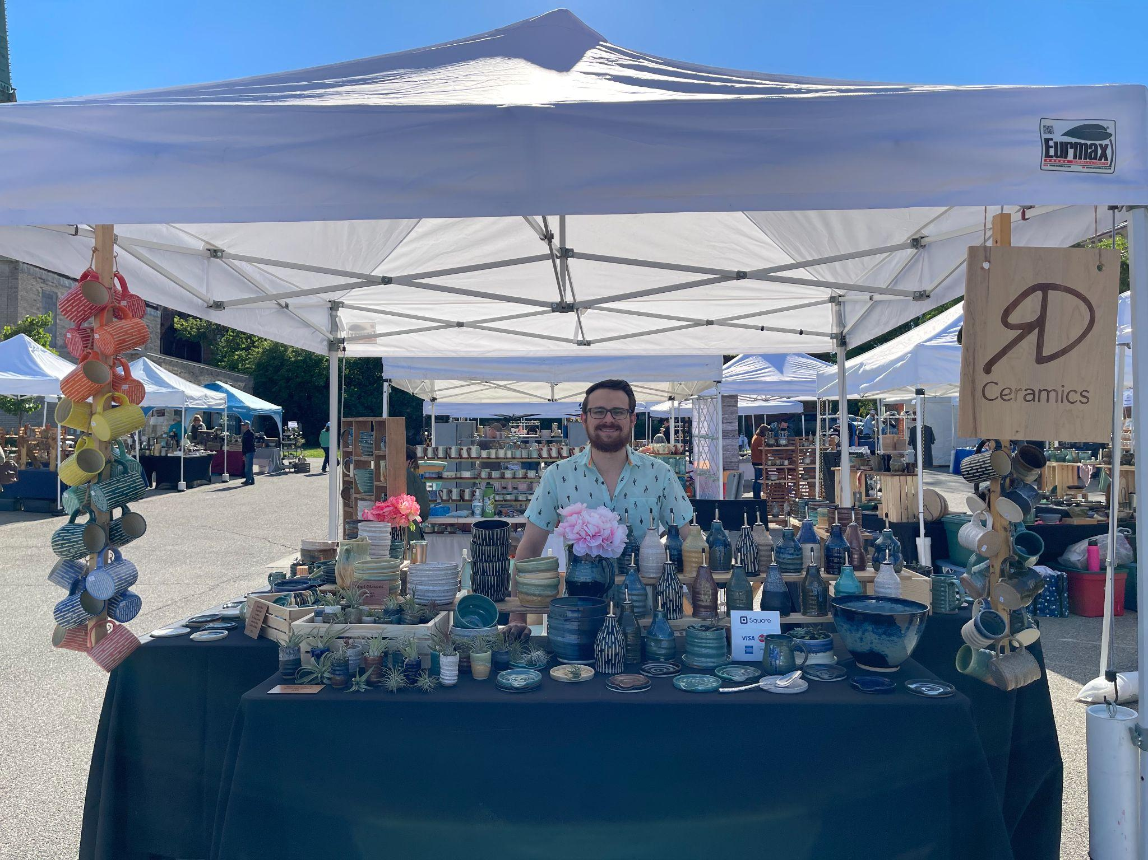
Preferred selling avenues
In-person shows
Wholesale
Online
Consignment
Commissions
Notes:
Why I like:
Shows
One-on-one with customers
Enjoy the process of setting up and tearing down for a weekend
Plethora of show options within a 2 hr radius of me
I build a repeat customer market for other shows, online, & future inquiries
Wholesale
Making the same thing over and over is great! Shot glasses!! Mugs!
Invoicing is simple and straightforward
Repeat orders are great and have room for future growth
Online
I choose when it’s convenient to post work
I can advertise for it on social media and drive purchases in a short period of time
Can be simple to photograph, list items, and ship out
Why these are lower on the list:
Consignment
I get requested to restock and it throws me off a bit
The inventory can take a big hit when restocking shops, can feel like I’m making a commission without payment quickly
Commissions
They never are high enough on my priority list to complete and I’m a people pleaser so that’s a tough balance

Slide 11
Real numbers from 2020 and 2021
2020 Revenue
Shows: 35%
Online: 46%
Consignment: 8%
Wholesale: 1%
Commissions: didn’t track
Others (teaching, direct, commissions): 10%
Total Revenue: ~$60k
2021 Revenue
Shows: 50%
Online: 29%
Consignment: 9%
Wholesale: 4%
Commissions: 4%
Others (teaching & direct): 3%
Total Revenue: ~$77k

Slide 12
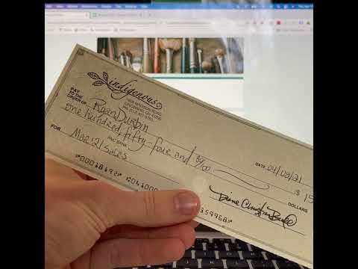
Keeping track of your income streams
RD Bookkeeping tool coming soon!
I’m working on a tutorial for inputting your expenses & income into a consolidated place
Easy to see how the business is doing any day of the year
Track various expense categories for your schedule C
Analytics about where your income is coming from
DM me on IG (@rdceramics) or email me if you want to be on the list to know when it goes live

Slide 13
Q&A
Please buy my stuff next door!
Mugs, oil bottles, bowls, planters
Wheel Talk Podcast - wheeltalk.buzzprout.com
@rdceramics (Instagram)
ryandurbinceramics@gmail.com
ryandurbinceramics.com
*Send me a message for first access to the RD Bookkeeping tool

